Slide 1
Python Basics

Slide 2




Highlights
Example
Question
Notes
Coding Style

Slide 3

Roadmap
Introduction
Objects, Variables, and Data Types
Strings, List and Dictionary
Control Flow Statements

Slide 4



Run! Python, Run!
Installation
Python
Jupyter Notebook (Anaconda)
IDEs (Pycharm/Spyder)

Slide 5
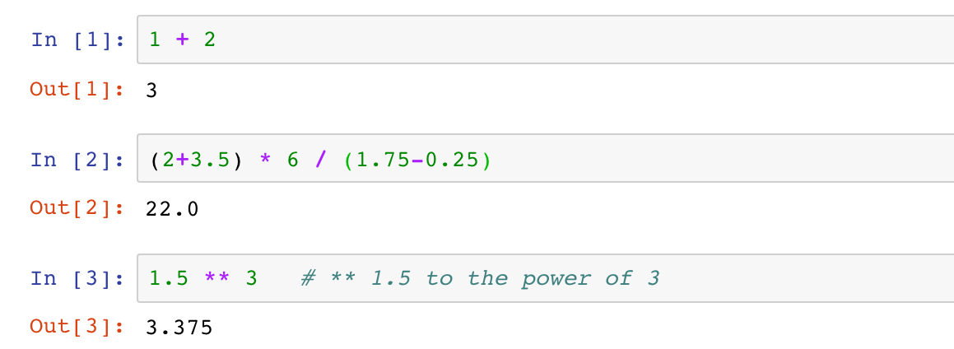
Run! Python, Run!
Interactive Shell Combining Code with Text
Try Python as a scientific calculator
Python arithmetic operators
Python code is executed line by line (cell by cell)

Slide 6


Run! Python, Run!
Interactive Shell Combining Code with Text
Try Python as a scientific calculator
Python arithmetic operators
Python code is executed line by line (cell by cell)
Notes
Splitting a statement into multiple lines is not allowed.

Slide 7

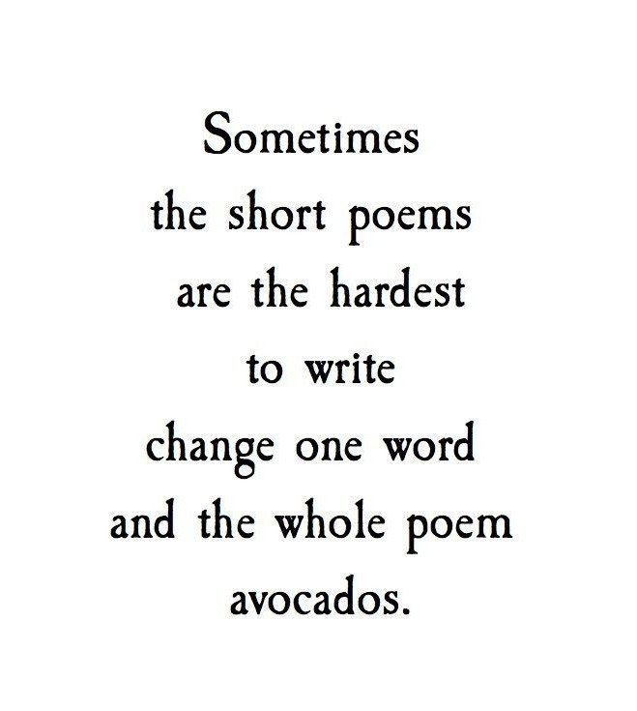
Run! Python, Run!
ith Text
ell by cell)
Interactive Shell Combining Code w
Try Python as a scientific calculator
Python arithmetic operators
Python code is executed line by line (c
Not allowed!!
Notes
Splitting a statement into multiple lines is not allowed.

Slide 8

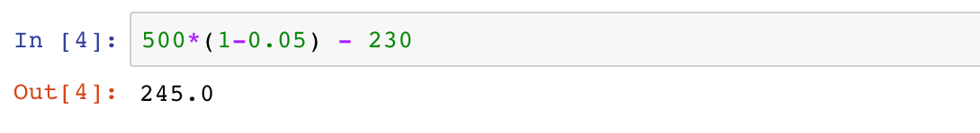
Run! Python, Run!
Interactive Shell Combining Code with Text
Try Python as a scientific calculator
Python arithmetic operators
Python code is executed line by line (cell by cell)
Example 1
A grocery store had 500 packs of cookies in storage. Among the total storage, 5% were dumped due to expiration, and another 230 packs were sold. Calculate how many packs of cookies are left in the grocery store.

Slide 9
Roadmap
Introduction
Objects, Variables, and Data Types
Strings, List and Dictionary
Control Flow Statements

Slide 10

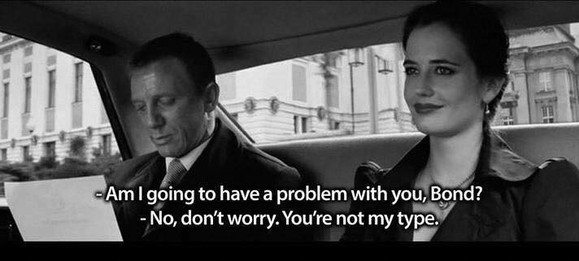
Objects, Variables, and Data Types

Slide 11
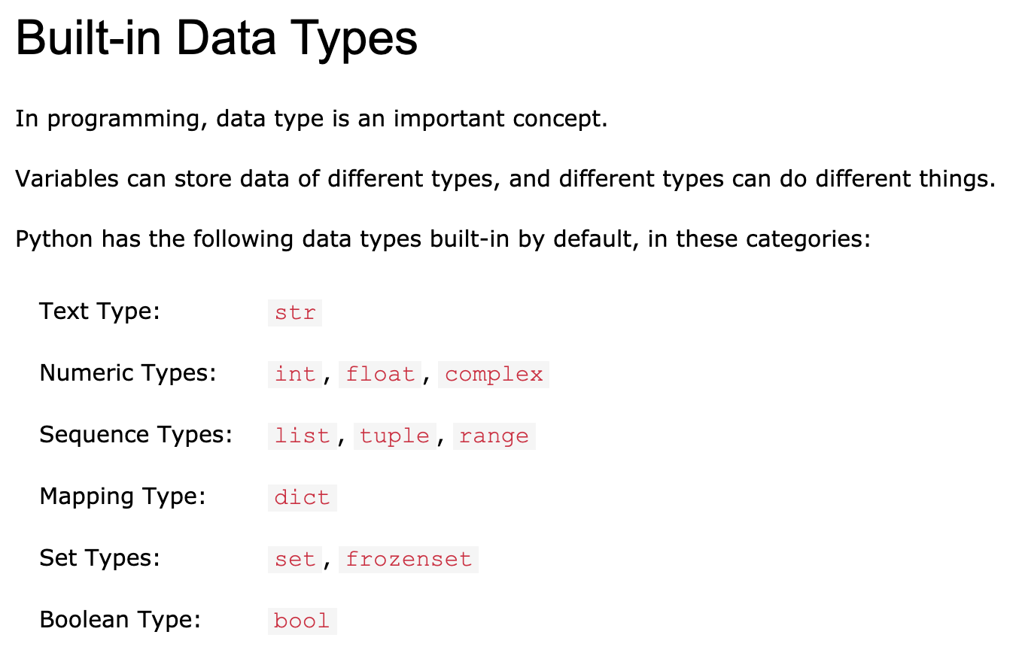
Objects, Variables, and Data Types
An Overview of Datatypes:
https://www.w3schools.com/python/python_datatypes.asp

Slide 12
Objects, Variables, and Data Types
Objects
Almost everything in Python is an object
Every object has a value and a type

Slide 13
Objects, Variables, and Data Types
Variables and Assignment Statements
Variables gives names to objects
Reuse the same value
Improve the readability
Enable control flow

Slide 14

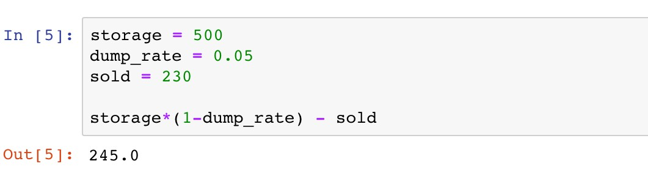
Objects, Variables, and Data Types
Variables and Assignment Statements
The value of a variable can be retrieved by invoking the name
Example 1
A grocery store had 500 packs of cookies in storage. Among the total storage, 5% were dumped due to expiration, and another 230 packs were sold. Calculate how many packs of cookies are left in the grocery store.

Slide 15
Objects, Variables, and Data Types
Variables and Assignment Statements
Assignment operator “="
Example 1
A grocery store had 500 packs of cookies in storage. Among the total storage, 5% were dumped due to expiration, and another 230 packs were sold. Calculate how many packs of cookies are left in the grocery store.

Slide 16
Objects, Variables, and Data Types
Variables and Assignment Statements
Variable(s): name(s) on the left
Example 1
A grocery store had 500 packs of cookies in storage. Among the total storage, 5% were dumped due to expiration, and another 230 packs were sold. Calculate how many packs of cookies are left in the grocery store.

Slide 17


Objects, Variables, and Data Types
Variables and Assignment Statements
Variable(s): name(s) on the left
Example 1
A grocery store had 500 packs of cookies in storage. Among the total storage, 5% were dumped due to expiration, and another 230 packs were sold. Calculate how many packs of cookies are left in the grocery store.
Notes
Only one “word”
Only consist of letters, numbers, and underscores
Cannot begin with a number
Avoid contradictions with Python keywords

Slide 18
Objects, Variables, and Data Types
Variables and Assignment Statements
Value(s): expression(s) on the right
Example 1
A grocery store had 500 packs of cookies in storage. Among the total storage, 5% were dumped due to expiration, and another 230 packs were sold. Calculate how many packs of cookies are left in the grocery store.

Slide 19
Objects, Variables, and Data Types
Variables and Assignment Statements
The value of a variable can be retrieved by invoking the name
Example 1
A grocery store had 500 packs of cookies in storage. Among the total storage, 5% were dumped due to expiration, and another 230 packs were sold. Calculate how many packs of cookies are left in the grocery store.

Slide 20


Objects, Variables, and Data Types
Variables and Assignment Statements
The value of a variable can be retrieved by invoking the name
Example 1
A grocery store had 500 packs of cookies in storage. Among the total storage, 5% were dumped due to expiration, and another 230 packs were sold. Calculate how many packs of cookies are left in the grocery store.
Coding Style
PEP 8 Style Guide:
Using empty lines for better readability

Slide 21
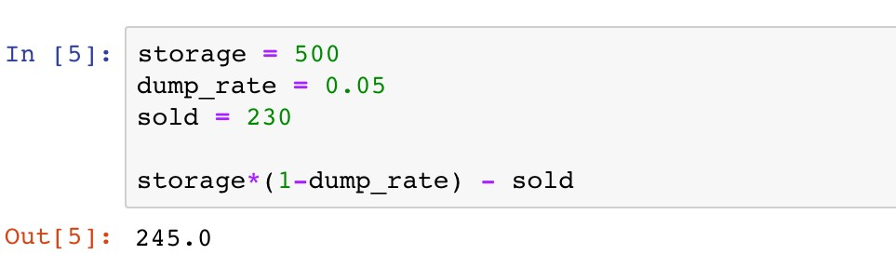
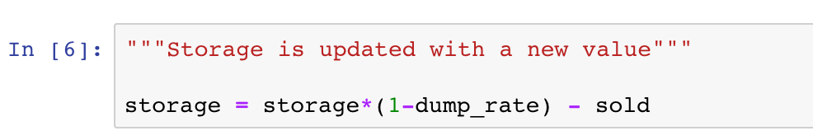
Objects, Variables, and Data Types
Variables and Assignment Statements
Assign new values to variables

Slide 22
Objects, Variables, and Data Types
Variables and Assignment Statements
Assign new values to variables

Slide 23
Objects, Variables, and Data Types
Variables and Assignment Statements
Assign new values to variables
500

Slide 24
Objects, Variables, and Data Types
Variables and Assignment Statements
Assign new values to variables
The new value 245 is assigned as the old one is forgotten

Slide 25


Objects, Variables, and Data Types
Variables and Assignment Statements
Assign new values to variables
Coding Style
PEP 8 Style Guide:
Function and variable names
Whitespace in expressions and statements

Slide 26

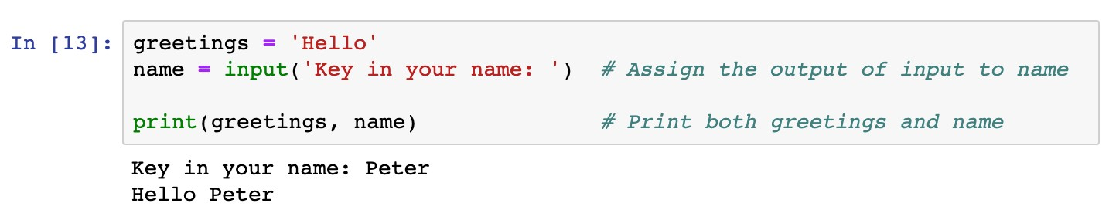
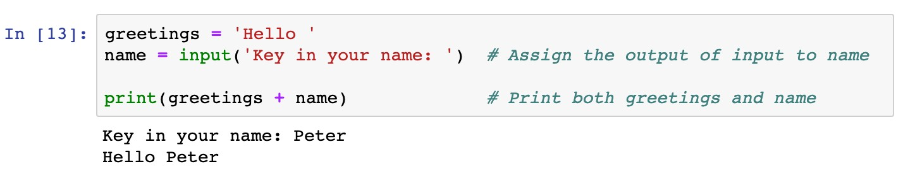
Objects, Variables, and Data Types
Variables and Assignment Statements
Assign values of function outputs to variables
Example 2
Use the “input” function in assignment statements

Slide 27
Objects, Variables, and Data Types
Variables and Assignment Statements
Assign values of function outputs to variables
Example 2
Use the “input” function in assignment statements
Functions: a block of organized, reusable code that is used to perform a single, related action

Slide 28
Objects, Variables, and Data Types
Variables and Assignment Statements
Assign values of function outputs to variables
Example 2
Use the “input” function in assignment statements

Slide 29
Objects, Variables, and Data Types
Variables and Assignment Statements
Assign values of function outputs to variables
Example 2
Use the “input” function in assignment statements
Output of the input function is the text given by users

Slide 30
Objects, Variables, and Data Types
Variables and Assignment Statements
Assign values of function outputs to variables
Example 2
Use the “input” function in assignment statements
Message displayed when users key in the text

Slide 31
Objects, Variables, and Data Types
Variables and Assignment Statements
Assign values of function outputs to variables
Example 2
Use the “input” function in assignment statements

Slide 32

Objects, Variables, and Data Types
Variables and Assignment Statements
Python vs Math
Question
Which assignment statement is correct?
x + y = 2
x * y = 1
2 = x
xy = 2
None of the above is correct

Slide 33
Objects, Variables, and Data Types
Variables and Assignment Statements
Other assignment operations
Operators
Remarks
Examples
+=
Equivalent to x Equivalent to x | = = | x x | + - | y y | x x | += -= | y y
Equivalent to x | = | x | * | y | x | *= | y
Equivalent to x | = | x | / | y | x | /= | y
-=
*=
/=
**=
Equivalent to x
= x**y
x **= y

Slide 34
Objects, Variables, and Data Types
Basic Built-in Data Types
Various types of data may be diﬀerent in nature
Data types determine how functions and operators work
Data types can be retrieved by function
type()

Slide 35
Objects, Variables, and Data Types
Basic Built-in Data Types
Numeric types
: signed integers
int
✓
float
: floating point real numbers
✓
long
and
complex:
long integers and complex numbers (not
covered in this course)

Slide 36
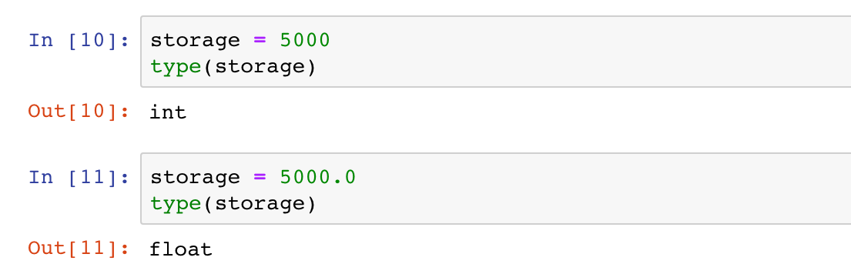
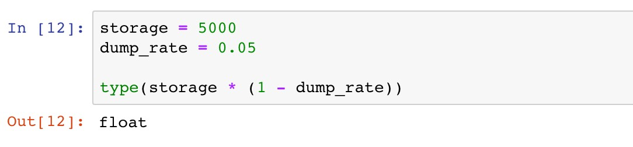
Objects, Variables, and Data Types
Basic Built-in Data Types
Numeric types

Slide 37
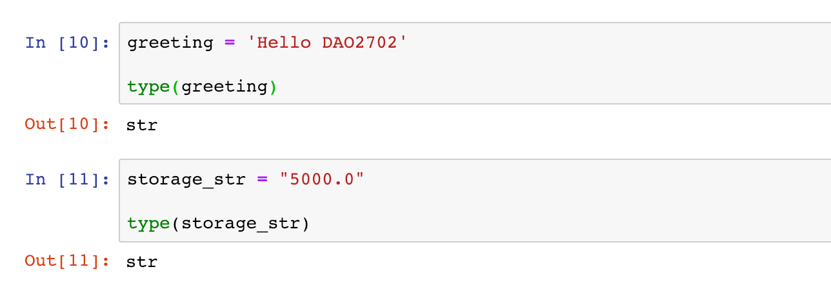
Objects, Variables, and Data Types
Basic Built-in Data Types
String:
str
Single or double quotation marks used in defining strings
Operators and can be used to manipulate strings
+
*

Slide 38
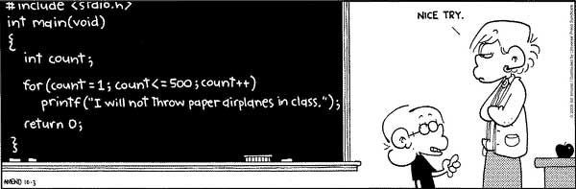
Objects, Variables, and Data Types
Basic Built-in Data Types
String:
str
Single or double quotation marks used in defining strings
Operators and can be used to manipulate strings
+
*
*
I QUIT TEACHING YOU …

Slide 39

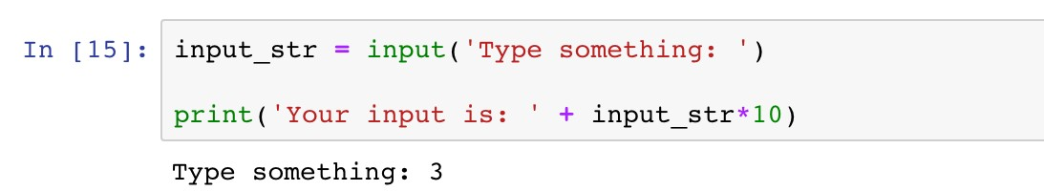
Objects, Variables, and Data Types
Basic Built-in Data Types
String:
str
Example 3
The function “input” enables users to type in a string of characters. Print a message “You input is:”, followed by the input string repeated ten times.

Slide 40
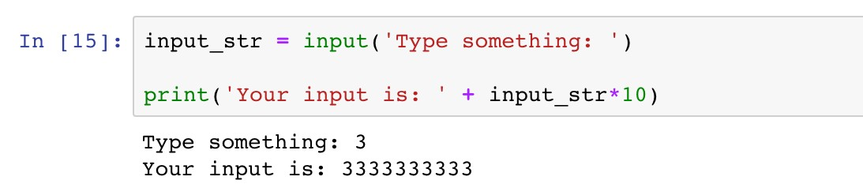
Objects, Variables, and Data Types
Basic Built-in Data Types
String:
str
Example 3
The function “input” enables users to type in a string of characters. Print a message “You input is:”, followed by the input string repeated ten times.
input_str is a string, so “+” combines strings, and “*” replicates strings.

Slide 41

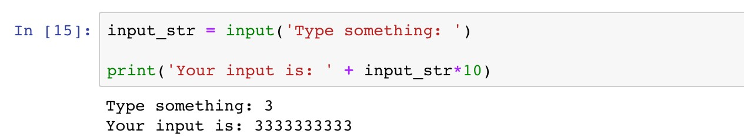
Objects, Variables, and Data Types
Basic Built-in Data Types
String:
str
HOW ABOUT MULTIPLYING THE INPUT NUMBER BY TEN?

Slide 42

Objects, Variables, and Data Types
Data Type Conversion
Enable manipulating data diﬀerently
Use type name as the conversion function
DATA TYPE CONVERSION!!

Slide 43
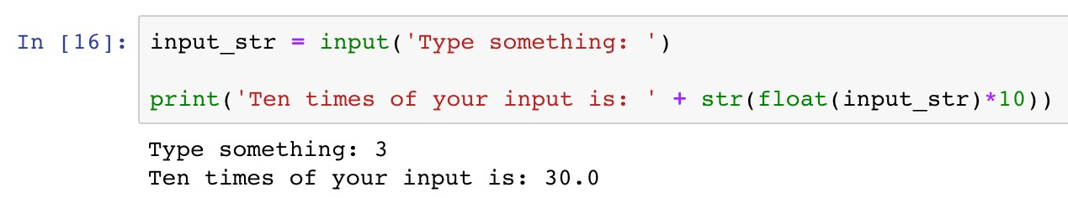
Objects, Variables, and Data Types
Data Type Conversion
Enable manipulating data diﬀerently
Use type name as the conversion function
DATA TYPE CONVERSION!!

Slide 44
Objects, Variables, and Data Types
Data Type Conversion
Enable manipulating data diﬀerently
Use type name as the conversion function
DATA TYPE CONVERSION!!
Convert the string to a floating point number

Slide 45
Objects, Variables, and Data Types
Data Type Conversion
Enable manipulating data diﬀerently
Use type name as the conversion function
DATA TYPE CONVERSION!!
Convert the floating point number back to a string

Slide 46

Objects, Variables, and Data Types
Data Type Conversion
BEFORE TYPE CONVERSION

Slide 47

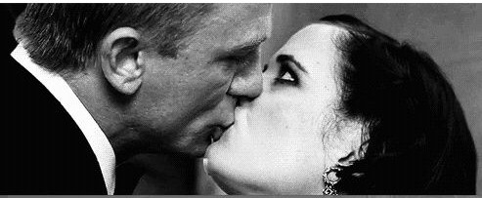
Objects, Variables, and Data Types
Data Type Conversion
BEFORE TYPE CONVERSION
AFTER TYPE CONVERSION

Slide 48

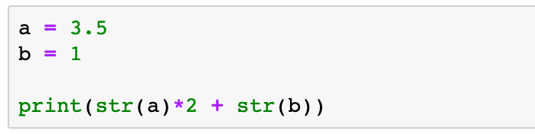
Objects, Variables, and Data Types
Data Type Conversion
Question
What is the output message of the following code?
A. 8
B. 3.53.51
C. 71
D. 3.53.51.0

Slide 49
Roadmap
Introduction
Objects, Variables, and Data Types
Strings, List and Dictionary
Control Flow Statements

Slide 50
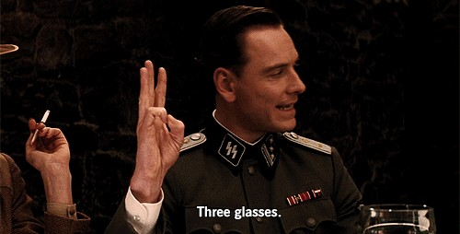
Strings
—“Three glasses” in Inglourious Basterds

Slide 51
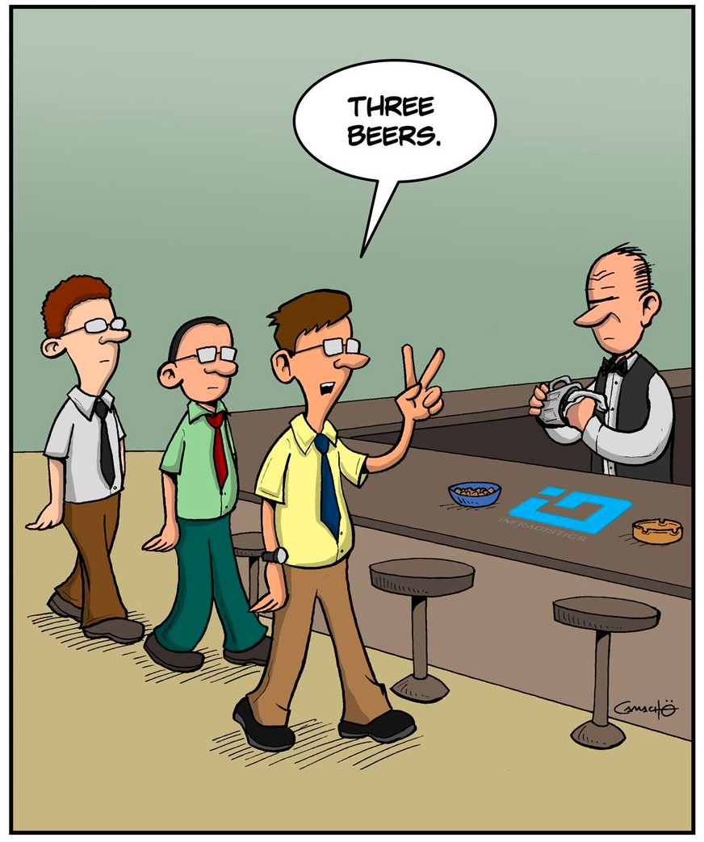
Strings
—“Three glasses” for Python programmers

Slide 52
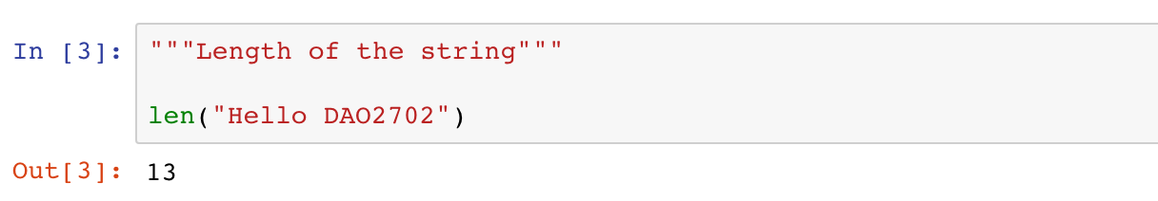
Strings
Strings are collections of characters
Length of a string (the number of characters)
13 characters
H | e | l | l | o |  | D | A | O | 2 | 7 | 0 | 2
0 1 2 3 4 5 6 7 8 9 10 11 12
-13 -12 -11 -10 -9 -8 -7 -6 -5 -4 -3 -2 -1

Slide 53
Strings
Strings are collections of characters
Accessing individual characters
13 characters
H | e | l | l | o |  | D | A | O | 2 | 7 | 0 | 2
0 1 2 3 4 5 6 7 8 9 10 11 12
-13 -12 -11 -10 -9 -8 -7 -6 -5 -4 -3 -2 -1

Slide 54
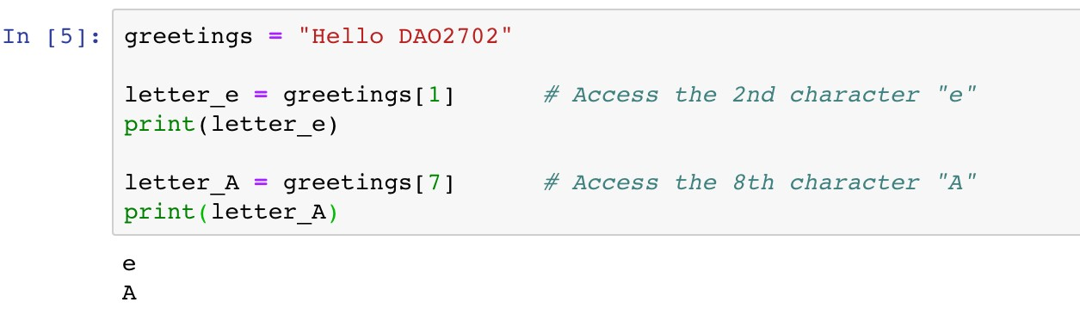
Strings
Strings are collections of characters
Accessing individual characters
13 characters
H |  | l | l | o |  | D |  | O | 2 | 7 | 0 | 2
0 |  | 2 | 3 | 4 | 5 | 6 |  | 8 | 9 | 10 | 11 | 12
e 1
A 7
Index
-13 -12 -11 -10 -9 -8 -7 -6 -5 -4 -3 -2 -1

Slide 55
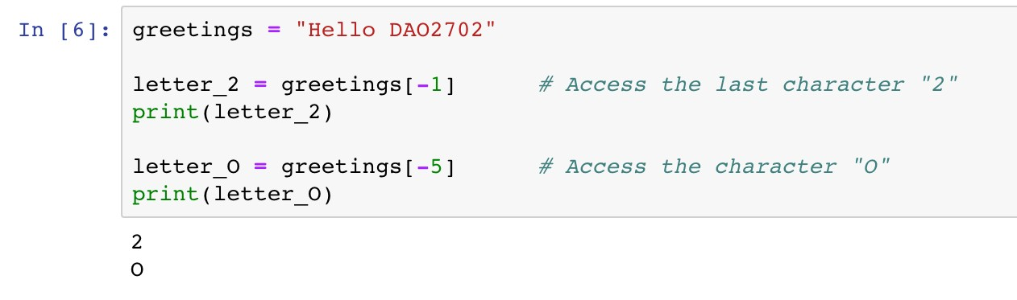
Strings
Strings are collections of characters
Accessing individual characters
13 characters
H | e | l | l | o |  | D | A |  | 2 | 7 | 0
0 | 1 | 2 | 3 | 4 | 5 | 6 | 7 |  | 9 | 10 | 11
-13 | -12 | -11 | -10 | -9 | -8 | -7 | -6 |  | -4 | -3 | -2
O 8
-5
2
12
-1
Index Index from rear

Slide 56
Strings
Strings are collections of characters
Slicing expression: access a subset of a string
13 characters
 |  | D | A | O | 2 | 7 | 0 | 2
 | 5 | 6 | 7 | 8 | 9 | 10 | 11 | 12
 | -8 | -7 | -6 | -5 | -4 | -3 | -2 | -1
H e l l o 0 1 2 3 4
-13 -12 -11 -10 -9
Index Index from rear

Slide 57
Strings
Strings are collections of characters
Slicing expression: access a subset of a string
[start:stop:step]
Arguments | Remarks | Default Values
start | The first index of the slice | 0
stop | The index before which the slice stops | Length of the string
step | The step length of the slice | 1

Slide 58
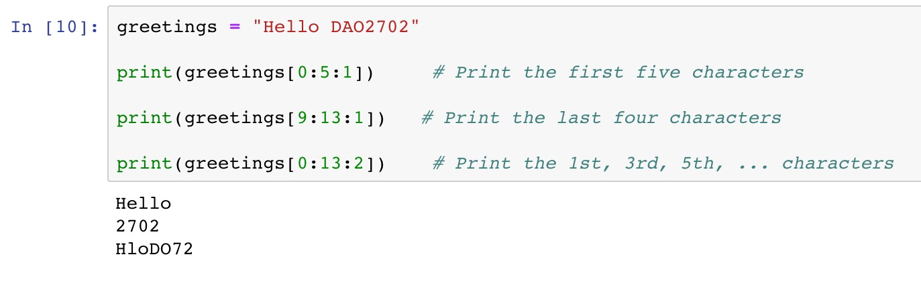
Strings
Strings are collections of characters
Slicing expression: access a subset of a string
13 characters
Index
 |  | D | A | O | 2 | 7 | 0 | 2
 | 5 | 6 | 7 | 8 | 9 | 10 | 11 | 12
H e l l o 0 1 2 3 4
-13 -12 -11 -10 -9 -8 -7 -6 -5 -4 -3 -2 -1
start
stop

Slide 59
Strings
Strings are collections of characters
Slicing expression: access a subset of a string
13 characters
Index
H | e | l | l | o |  | D | A | O
0 | 1 | 2 | 3 | 4 | 5 | 6 | 7 | 8
2 7 0 2
9 10 11 12
-13 -12 -11 -10 -9 -8 -7 -6 -5 -4 -3 -2 -1
start
stop

Slide 60
Strings
Strings are collections of characters
Slicing expression: access a subset of a string
13 characters
Index
 | e |  | l |  |  |  | A |  | 2 |  | 0
 | 1 |  | 3 |  | 5 |  | 7 |  | 9 |  | 11
H 0
l 2
o 4
D 6
O 8
7
10
2
12
-13 -12 -11 -10 -9 -8 -7 -6 -5 -4 -3 -2 -1
start
stop
step

Slide 61
Strings
Strings are collections of characters
Slicing expression
Arguments
Default Values
start 0
Unspecified
stop
Length of the string
step 1
[0:5:1]
[0:5:1]
[:5]
13 characters
Index
 |  | D | A | O | 2 | 7 | 0 | 2
 | 5 | 6 | 7 | 8 | 9 | 10 | 11 | 12
H e l l o 0 1 2 3 4
-13 -12 -11 -10 -9 -8 -7 -6 -5 -4 -3 -2 -1
start
stop

Slide 62

Strings
Strings are collections of characters
Slicing expression
Arguments
Default Values
start
0
Unspecified
stop Length of the string
step 1
[9:13:1]
[9:13:1]
[9:]
[-4:13:1]
[-4:13:1]
[-4:]
13 characters
Index Index from rear
H | e | l | l | o |  | D | A | O
0 | 1 | 2 | 3 | 4 | 5 | 6 | 7 | 8
-13 | -12 | -11 | -10 | -9 | -8 | -7 | -6 | -5
2 7 0 2
9 10 11 12
-4 -3 -2 -1
start
stop

Slide 63
Strings
Strings are collections of characters
Slicing expression
Arguments Default Values
step 1
start 0
Unspecified
stop Length of the string
[0:13:2]
[0:13:2]
[::2]
13 characters
Index
 | e |  | l |  |  |  | A |  | 2 |  | 0
 | 1 |  | 3 |  | 5 |  | 7 |  | 9 |  | 11
H 0
l 2
o 4
D 6
O 8
7
10
2
12
-13 -12 -11 -10 -9 -8 -7 -6 -5 -4 -3 -2 -1
start
stop
step

Slide 64

Strings
Strings are collections of characters
Slicing expression: access a subset of a string
Notes
A common mistake is assuming that the last index of the slice is stop. Please be very careful that the last index should be the last available integer before stop.

Slide 65

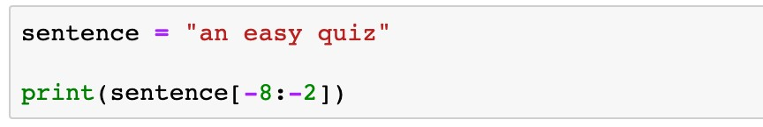
Strings
Strings are collections of characters
Indexing and slicing expression
Question
What is the printed message of the following code?
easy q
easy
asy qu
asy qui

Slide 66
Strings
Strings are collections of characters
Iterate characters via
range
✓
range
is a built-in data type that defines a sequence of integers
It is used in the form of
range(start, stop, step)
Arguments | Remarks | Default Values
start | The first index of the integer sequence | 0
stop | The index before which the sequence stops | -
step | The step length of the integer sequence | 1

Slide 67
Strings
Strings are collections of characters
Iterate characters via
range
✓
range
is a built-in data type that defines a sequence of integers
It is used in the form of
Examples
range(start, stop, step)
range(0, | 5, | 1) | 0, | 1, | 2, | 3, | 4
range(0, | 3) |  | 0, | 1, | 2
range(6) |  |  | 0, | 1, | 2, | 3, | 4, | 5

Slide 68
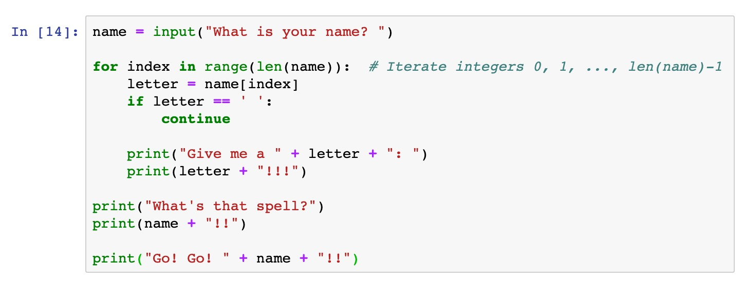
Strings
Strings are collections of characters
Iterate characters via
range
Use
range
as the index of characters

Slide 69
Strings
Strings are collections of characters
Iterate characters via
range
Use
range
as the index of characters
name range(len(name))
J | a | c | k
0 | 1 | 2 | 3

Slide 70
Strings
Strings are collections of characters
Iterate characters via
range
Use
range
as the index of characters
name[index]
1st iteration
J
name range(len(name))
J | a | c | k
0 | 1 | 2 | 3
1st iteration
index
0

Slide 71
Strings
Strings are collections of characters
Iterate characters via
range
Use
range
as the index of characters
name[index]
a
2nd iteration
name
range(len(name))
2nd iteration
J | a | c | k
0 | 1 | 2 | 3
index
1

Slide 72
Strings
Strings are collections of characters
Iterate characters via
range
Use
range
as the index of characters
name[index]
3rd iteration
c
name range(len(name))
J | a | c | k
0 | 1 | 2 | 3
3rd iteration
index
2

Slide 73
Strings
Strings are collections of characters
Iterate characters via
range
Use
range
as the index of characters
name[index]
4th iteration
k
name range(len(name))
J | a | c | k
0 | 1 | 2 | 3
4th iteration
index
3

Slide 74
Strings
Methods of strings
A method is a special function associated with an object
A method is called via the syntax
<object>.<method>(
)

Slide 75
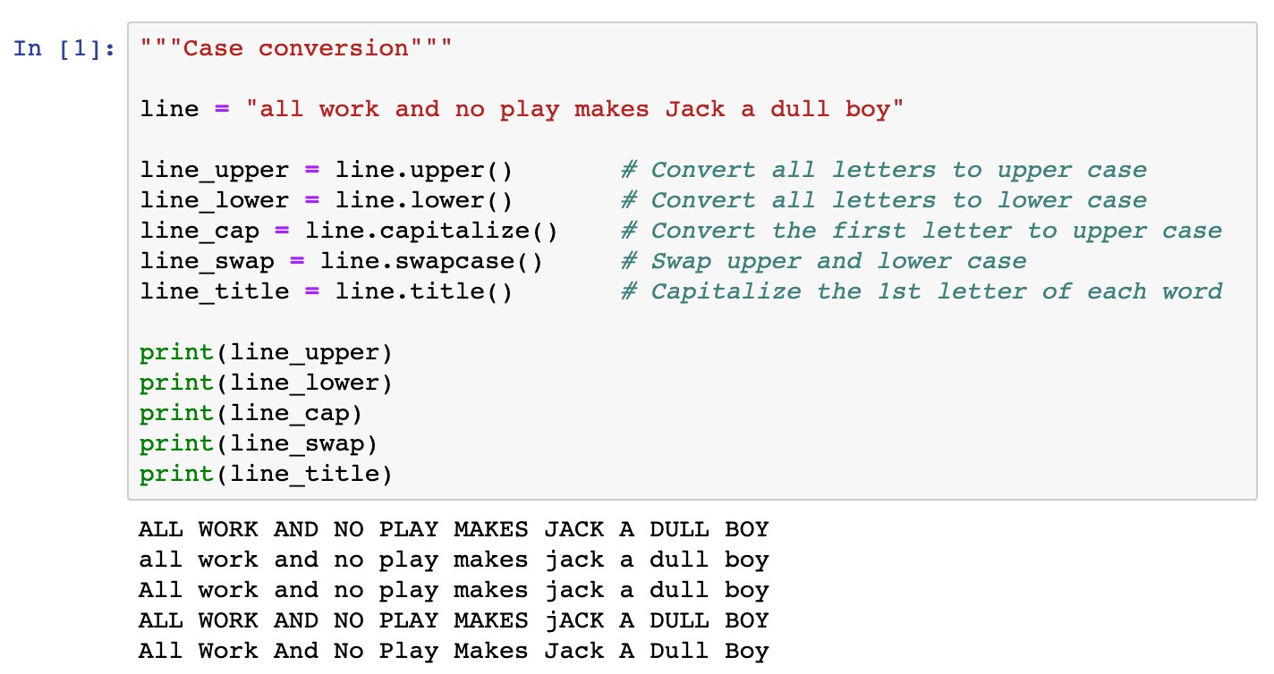
Strings
Methods of strings
Case conversion

Slide 76
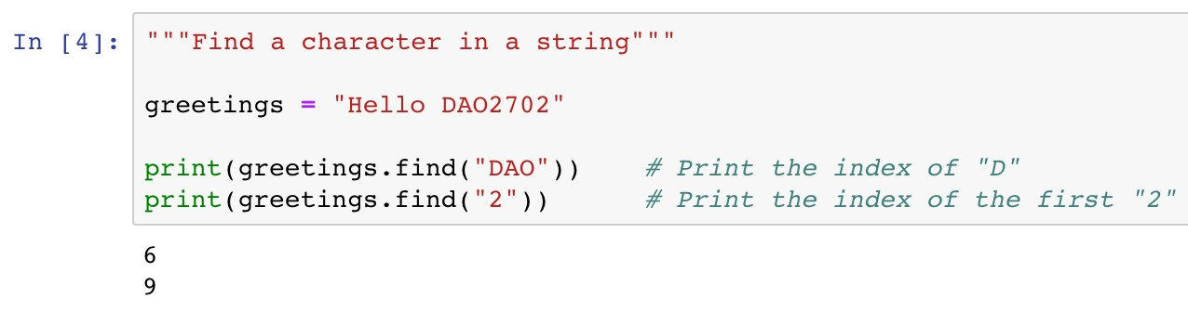
Strings
Methods of strings
Search items in a string
This method returns -1 if the given item cannot be found
13 characters
H | e | l | l | o |  | D | A | O | 2 | 7 | 0 | 2
0 | 1 | 2 | 3 | 4 | 5 | 6 | 7 | 8 | 9 | 10 | 11 | 12
-13 -12 -11 -10 -9 -8 -7 -6 -5 -4 -3 -2 -1

Slide 77
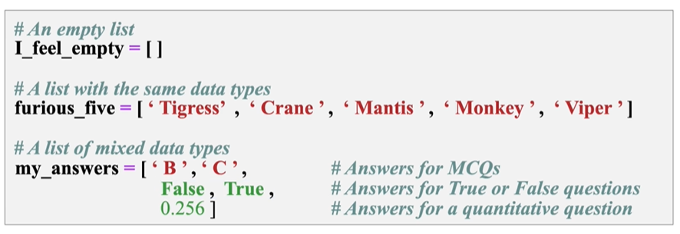
List
List
a collection which is ordered and changeable. Allows duplicate members
0 1 2 3 4 5 6 7 8 9 10 11 12
-13 -12 -11 -10 -9 -8 -7 -6 -5 -4 -3 -2 -1

Slide 78
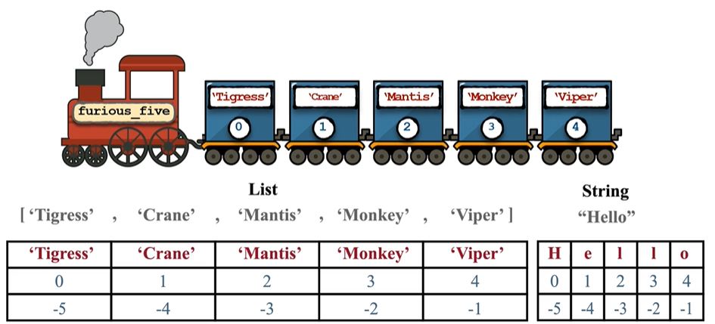
Similarities between list and strings
Similarity: Indexing and slicing
0 1 2 3 4 5 6 7 8 9 10 11 12
-13 -12 -11 -10 -9 -8 -7 -6 -5 -4 -3 -2 -1

Slide 79
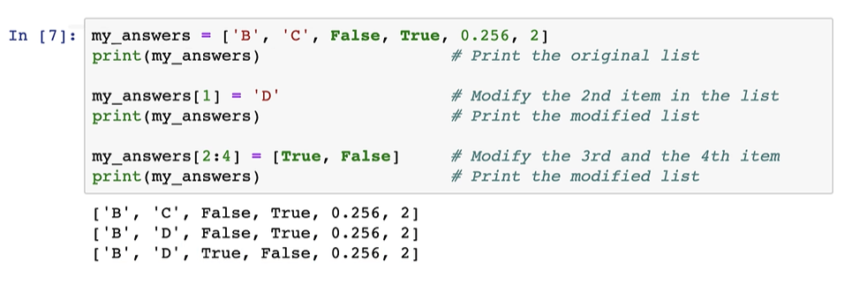
Differences between list and strings
Mutability: element-wise segment
If you try to change some characters in a string via indexing and slicing, an error message will be given!
0 1 2 3 4 5 6 7 8 9 10 11 12
-13 -12 -11 -10 -9 -8 -7 -6 -5 -4 -3 -2 -1

Slide 80
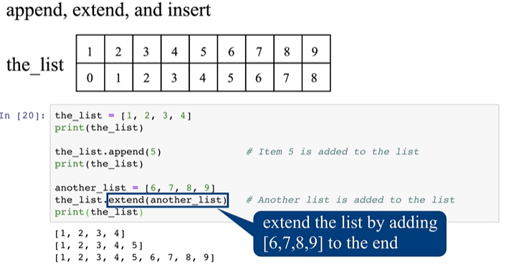
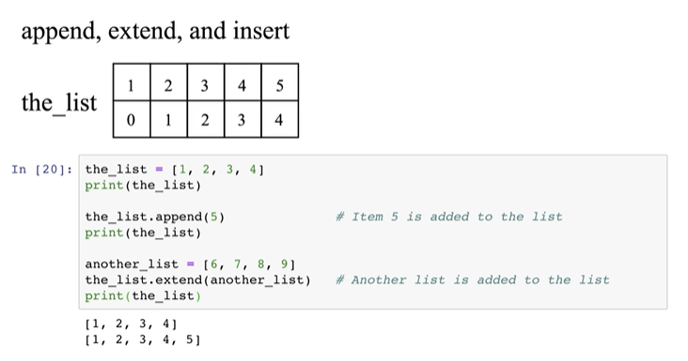
List methods
List
Append, extend a list
0 1 2 3 4 5 6 7 8 9 10 11 12
-13 -12 -11 -10 -9 -8 -7 -6 -5 -4 -3 -2 -1

Slide 81
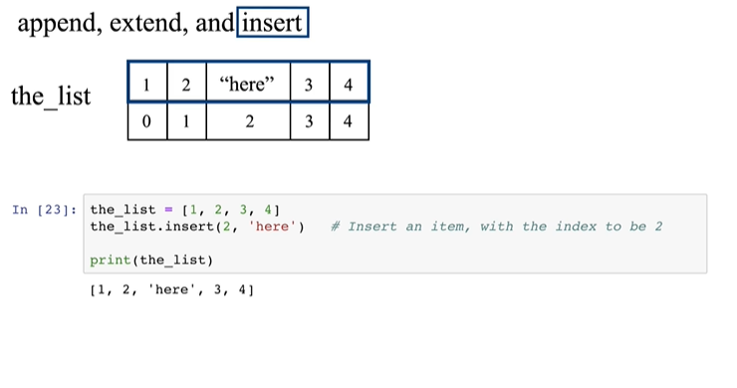
List methods
List
Insert an element to a list
0 1 2 3 4 5 6 7 8 9 10 11 12
-13 -12 -11 -10 -9 -8 -7 -6 -5 -4 -3 -2 -1

Slide 82
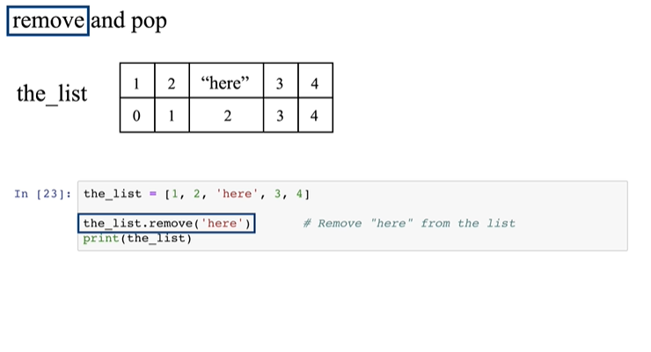
List methods
List
Remove an element from the list using remove()
0 1 2 3 4 5 6 7 8 9 10 11 12
-13 -12 -11 -10 -9 -8 -7 -6 -5 -4 -3 -2 -1

Slide 83
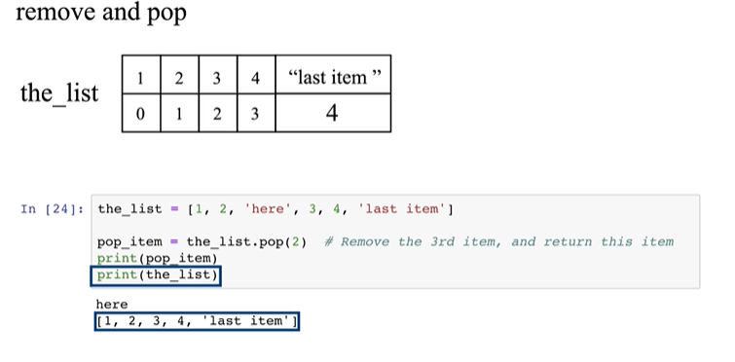
List methods
List
Remove an element from the list using pop()
0 1 2 3 4 5 6 7 8 9 10 11 12
-13 -12 -11 -10 -9 -8 -7 -6 -5 -4 -3 -2 -1

Slide 84
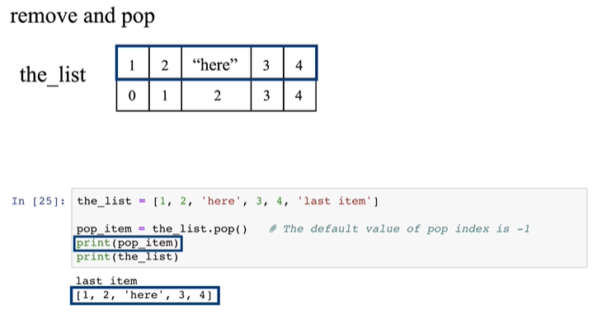
List methods
List
Remove an element from the list using pop()
0 1 2 3 4 5 6 7 8 9 10 11 12
-13 -12 -11 -10 -9 -8 -7 -6 -5 -4 -3 -2 -1

Slide 85
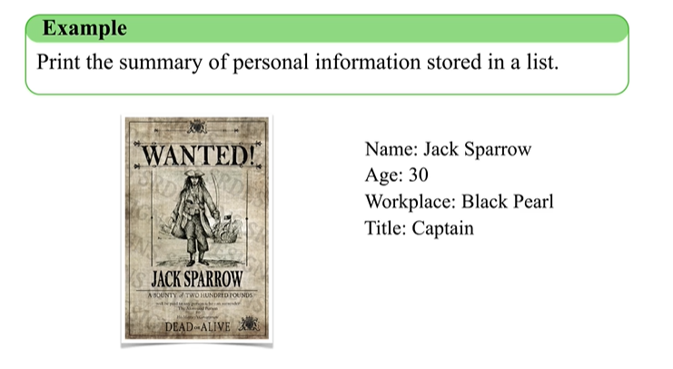
Dictionary
Dictionary
0 1 2 3 4 5 6 7 8 9 10 11 12
-13 -12 -11 -10 -9 -8 -7 -6 -5 -4 -3 -2 -1

Slide 86
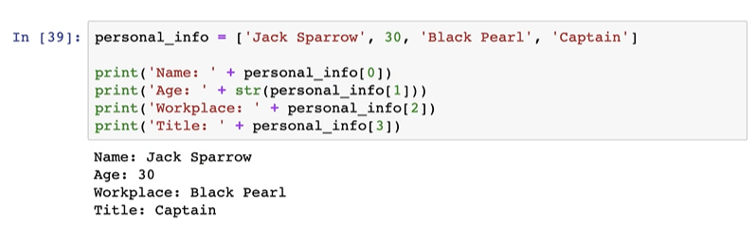
Dictionary
Dictionary
Is this a good method?
0 1 2 3 4 5 6 7 8 9 10 11 12
-13 -12 -11 -10 -9 -8 -7 -6 -5 -4 -3 -2 -1

Slide 87
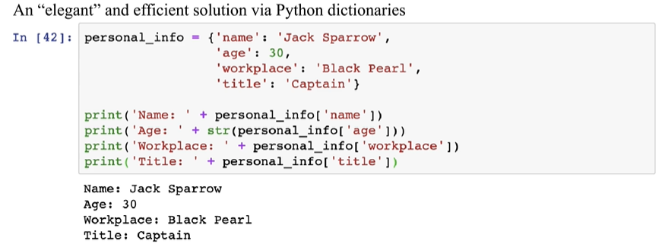
Dictionary
Dictionary
0 1 2 3 4 5 6 7 8 9 10 11 12
-13 -12 -11 -10 -9 -8 -7 -6 -5 -4 -3 -2 -1

Slide 88
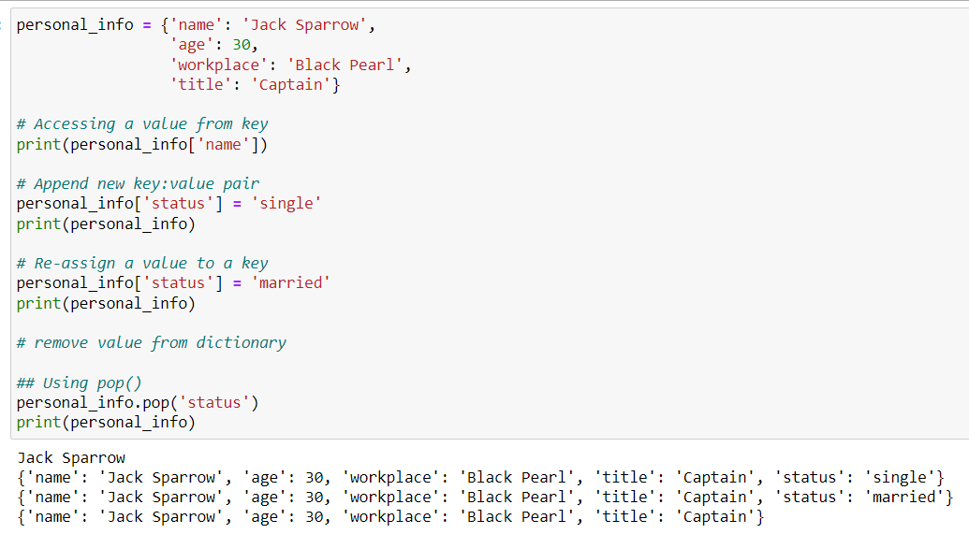
Dictionary
Dictionary
0 1 2 3 4 5 6 7 8 9 10 11 12
-13 -12 -11 -10 -9 -8 -7 -6 -5 -4 -3 -2 -1

Slide 89
Roadmap
Introduction
Objects, Variables, and Data Types
Strings
Control Flow: Boolean Type

Slide 90
Control Flow: Boolean Type
The Boolean Type Expressions
Status:
True
or
False
Comparison operators
Operators
Remarks
Example
==
Equal
Not equal
Greater than or equal to Smaller than or equal to Greater than
Smaller than
x == y x != y x >= y x <= y x > y
x < y
!=
>=
<=
>
<

Slide 91
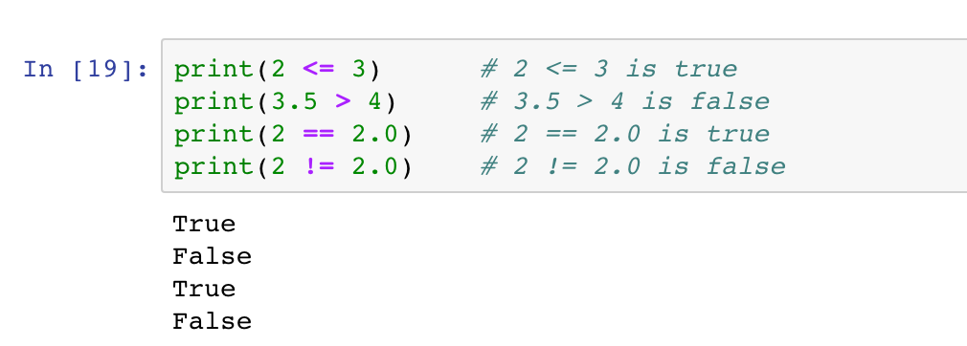
Control Flow: Boolean Type
The Boolean Type Expressions
Status:
True
or
False
Comparison operators

Slide 92
Control Flow: Boolean Type
The Boolean Type Expressions
Status:
True
or
False
Identity operators
Operators
Remarks
Examples
x is y
is
Returns True if both variables are the same object
is not
Returns True if two variables are not the same object
x is not y

Slide 93
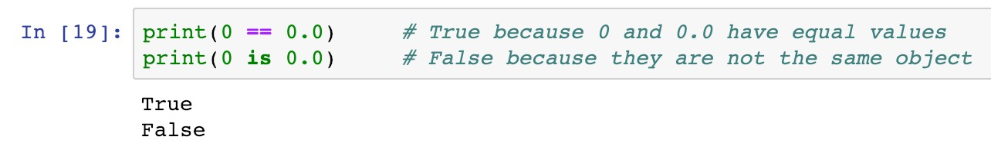
Control Flow: Boolean Type
The Boolean Type Expressions
Status:
True
or
False
Identity operators
Operators
Remarks
Examples
x is y
is
Returns True if both variables are the same object
is not
Returns True if two variables are not the same object
x is not y

Slide 94
Control Flow: Boolean Type
The Boolean Type Expressions
Status:
True
or
False
Membership operators
Operators
Remarks
Examples
x in y
in
Returns True if it finds variable in the specified sequence and False otherwise
not in
Returns False if it finds variable in the specified sequence and True otherwise
x not in y

Slide 95
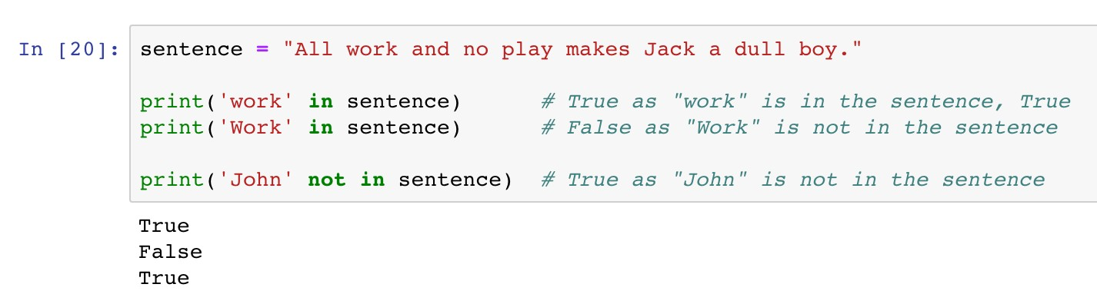
Control Flow: Boolean Type
The Boolean Type Expressions
Status:
True
or
False
Membership operators

Slide 96
Control Flow: Boolean Type
The Boolean Type Expressions
Status:
True
or
False
Logic operators
Operators
Remarks
Examples
x >= 1 and y <= 1
< 1
and
Returns True if
both statements are True
Returns True if either one statements is True
Reverse the result, returns False if the result
or
x > 1 or y
not x == 0
not

Slide 97
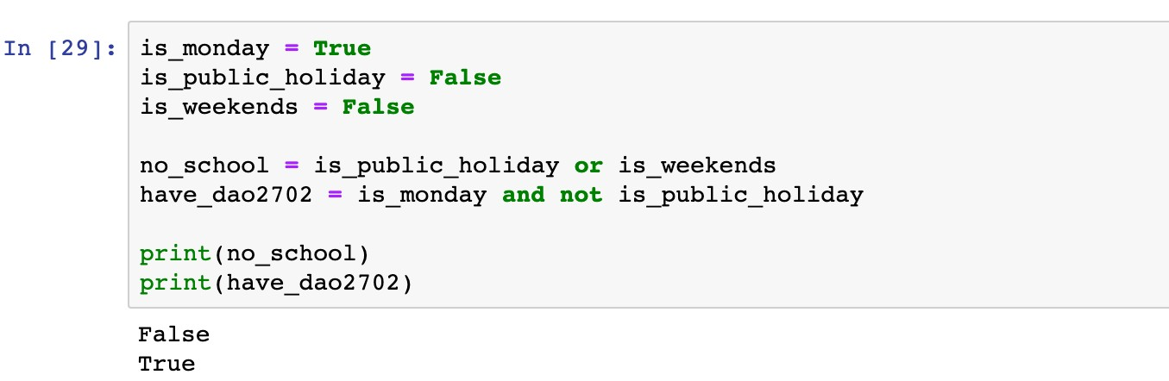
Control Flow: Boolean Type
The Boolean Type Expressions
Status:
True
or
False
Logic operators

Slide 98
Control Flow: Boolean Type
The Boolean Type Expressions
Status:
True
or
False
Logic operators
The condition is True if at least one statement is True

Slide 99
Control Flow: Boolean Type
The Boolean Type Expressions
Status:
True
or
False
Logic operators
The condition is True if both statements are True

Slide 100
Roadmap
Introduction
Objects, Variables, and Data Types
Strings
Control Flow: if

Slide 101
Control Flow: from Boolean Type…
Conditional Statements
The
if-elif-else
syntax enables diﬀerent actions according
to the status of given boolean expressions.

Slide 102
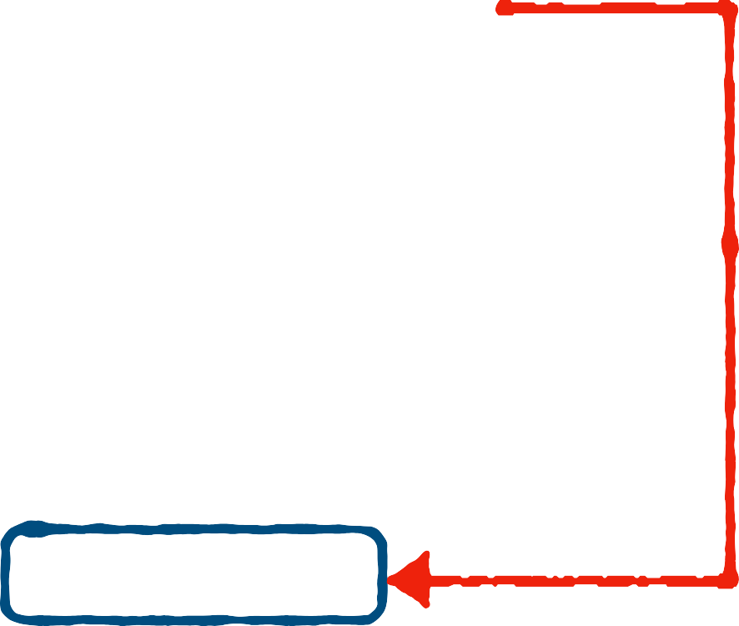

Control Flow: if
Conditional Statements
if
<boolean statement 1>:
<code body 1>
<code body 2>
The
if
syntax
if
Keyword
Execute <code body 1> if
<boolean statement 1> is and skip it if otherwise
Indent (a tab or four spaces)
<code body 1> to diﬀerentiate it from <code body 2>
if
False
<boolean statement 1>:
True
<code body 1>
True,
<code body 2>

Slide 103

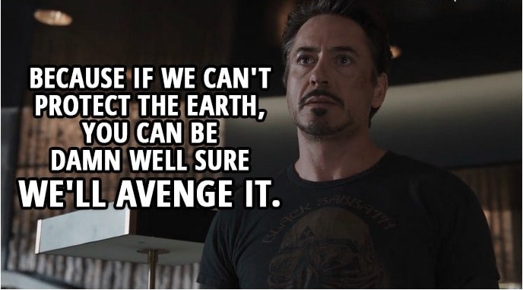
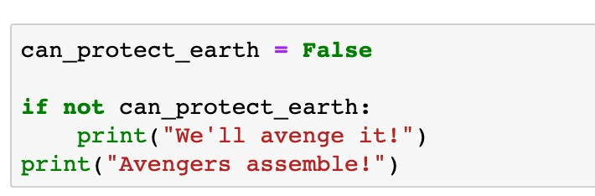
Control Flow: if
Conditional Statements
The
if
syntax

Slide 104

Control Flow: if
Conditional Statements
The
if
syntax

Slide 105
Control Flow: if
Conditional Statements
The
if
syntax
Do not forget the colon
Keyword

Slide 106


Control Flow: if
Conditional Statements
The
if
syntax
Execute this line if the condition is True
Indentation (a tab or four spaces)

Slide 107
Control Flow: if
Conditional Statements
The
if
syntax
This line is out of the conditional statement

Slide 108
Control Flow: if
Conditional Statements
The
if
syntax
What is the printed message if
is
can_protect_earth
True

Slide 109

Control Flow: if-else
Conditional Statements
if
<boolean statement 1>:
<code body 1>
:
<code body 2>
<code body 3>
False
<boolean statement 1>:
The
if-else
syntax
else
if
else
Keyword and
Execute <code body 1> if
<boolean statement 1> is
Execute <code body 2> if
<boolean statement 1> is
Same indentations for
if
True
True
<code body 1>
else
: <code body 2>
False
else
<code body 3>

Slide 110

Control Flow: if-else
Conditional Statements
The
if-else
syntax

Slide 111

Control Flow: if-else
Conditional Statements
The
if-else
syntax

Slide 112
Control Flow: if-else
Conditional Statements
The
if-else
syntax
Execute this line if the condition is False
Indentation (a tab or four spaces)

Slide 113




Control Flow: if-elif-else
Conditional Statements
if
<boolean statement 1>:
<code body 1>
The
if-elif-else
syntax
elif
: <boolean statement 2>:
<code body 2>
Keyword elif to add more conditions
else
:
<code body 3>
<code body 4>
False
<boolean statement 1>:
if
True
<code body 1>
elif
<boolean statement 2>:
False
True
<code body 2>
else
: <code body 3>
<code body 4>

Slide 114

Control Flow: if
Conditional Statements
Example 4
The price of ticket for Disneyland is $35 for adults, and $16 for senior citizens (60 years old or above). The ticket price for children aged 3 to 12 years old, is $23, and it is free for children under 3 years old. Write a program to determine the ticket price given a visitor’s age.

Slide 115





Control Flow: if
Conditional Statements
if
age < 3:
False
True
price = 0
elif
age <= 12:
False
True
price = 23
elif
age < 60:
False
True
price = 35
else
: price = 16
print(price)

Slide 116

Control Flow: if
Conditional Statements
Example 4
The price of ticket for Disneyland is $35 for adults, and $16 for senior citizens (60 years old or above). The ticket price for children aged 3 to 12 years old, is $23, and it is free for children under 3 years old. Write a program to determine the ticket price given a visitor’s age.

Slide 117


Control Flow: if
Conditional Statements
Question
What is the output message of the following code?
5
True
False
1

Slide 118


Control Flow: if
Conditional Statements
The nested if-elif-else structure

Slide 119

Control Flow: if
Conditional Statements
The nested if-elif-else structure

Slide 120


Control Flow: if
Conditional Statements
The nested if-elif-else structure
Leftover only occur in the case that demand is lesser than order

Slide 121
Roadmap
Introduction
Objects, Variables, and Data Types
Strings
Control Flow: while

Slide 122


Control Flow: while
Iterations and loops
while
<boolean statement>:
<code body to be repeated>
<other code>
The
while
loop
while
Keyword
Check the status of
<boolean statement> in each iteration
Repeatedly Execute <code to be repeated> if <boolean statement> is
Same indentations for
<code to be repeated>
while
False
<boolean statement>:
True
<code to be repeated>
True
<other code>

Slide 123


Control Flow: while
Iterations and loops
The
while
loop

Slide 124



Control Flow: while
Iterations and loops
The
while
loop
Example 1
In the movie Dr. Strange (2016), Steven Strange beat the supervillain "Dormammu" by keeping annoying him until he was extremely bored and frustrated. Write a program to act like Dr. Strange. The "time" loop can only be broken when you type in "I quit" or "You win".
False
<boolean statement>:
True
<code to be repeated>
while
<other code>

Slide 125


Control Flow: while
Iterations and loops
The
while
loop
Example 1
In the movie Dr. Strange (2016), Steven Strange beat the supervillain "Dormammu" by keeping annoying him until he was extremely bored and frustrated. Write a program to act like Dr. Strange. The "time" loop can only be broken when you type in "I quit" or "You win".
False
Dormammu not quit:
True
I’ve come to bargain What does Dormammu say?
Movie ends
while

Slide 126

Control Flow: while
Iterations and loops
The
while
loop
Example 1
In the movie Dr. Strange (2016), Steven Strange beat the supervillain "Dormammu" by keeping annoying him until he was extremely bored and frustrated. Write a program to act like Dr. Strange. The "time" loop can only be broken when you type in "I quit" or "You win".

Slide 127


Control Flow: while
Iterations and loops
while
False
Dormammu not quit:
The
while
loop
True
I’ve come to bargain What does Dormammu say?
Movie ends
Check the condition in each iteration
Indentation
Loop body

Slide 128
Control Flow: while
Iterations and loops
while
False
Dormammu not quit:
The
while
loop
True
I’ve come to bargain What does Dormammu say?
Movie ends
An inner conditional statement to check if Dormammu quits

Slide 129
Control Flow: while
Iterations and loops
while
False
Dormammu not quit:
The
while
loop
True
I’ve come to bargain What does Dormammu say?
Movie ends
Extra Indentation
Extra Indentation
Execute if the boolean condition is True
Execute if the boolean condition is False

Slide 130
Control Flow: while
Iterations and loops
while
False
Dormammu not quit:
The
while
loop
True
I’ve come to bargain What does Dormammu say?
Movie ends
True
Change the boolean status to stop the loop

Slide 131

Control Flow: while
Iterations and loops
The
while
loop
Example 1
In the movie Dr. Strange (2016), Steven Strange beat the supervillain "Dormammu" by keeping annoying him until he was extremely bored and frustrated. Write a program to act like Dr. Strange. The "time" loop can only be broken when you type in "I quit" or "You win".

Slide 132


Control Flow: while
Iterations and loops
while
True:
The
while
loop
True
I’ve come to bargain
if Dormammu says “quit” ?
True
break
Movie ends
Always True
Indentation
Loop body

Slide 133
Control Flow: while
Iterations and loops
while
True:
The
while
loop
True
I’ve come to bargain
if Dormammu says “quit” ?
True
break
Movie ends
Stop the loop immediately

Slide 134
Control Flow: while
Iterations and loops
The
while
loop
while
Keyword
Indentations for the code block to be repeated
Stoping criterion
Indefinite iterations (unknown number of iterations)

Slide 135
Roadmap
Introduction
Objects, Variables, and Data Types
Strings
Control Flow: for

Slide 136


Control Flow: for
Iterations and loops
The
for
loop
for
<item> in <sequence>:
<code body to be repeated>
<other code>
for
in
Keywords and
In each iteration, <item> takes one value from
<sequence>
The number of iterations is the number of values in <sequence>
Same indentations for
<code to be repeated>
for
<item>
in
<sequence>:
<item> takes one value
<code to be repeated>
Loop stops
<other code>

Slide 137

Control Flow: for
Iterations and loops
The
for
loop
Example 2 Cheerleader chant
for
<item>
in
<sequence>:
<item> takes one value
<code to be repeated>
Loop stops
<other code>

Slide 138

Control Flow: for
Iterations and loops
for
in
letter name:
letter takes each letter
Shout out each letter
The
loop
Loop stops
for
Example 2 Cheerleader chant
Go! Go!

Slide 139

Control Flow: for
Iterations and loops
The
for
loop
If letter is a whitespace
Skip the subsequent code and continue to the next iteration
Extra Indentation

Slide 140




Control Flow: for
Iterations and loops
for
in
letter name:
letter takes each letter
Shout out each letter
The
for
loop
Loop stops
Take each letter from name in each iteration
Go! Go!
Indentation
Loop body

Slide 141
Control Flow: for
Iterations and loops
The
for
loop
name
J | a | c | k
Take each letter from name in each iteration
Indentation
Loop body

Slide 142
Control Flow: for
Iterations and loops
The
for
loop
name
J | a | c | k
1st iteration
letter
Take each letter from
name in each iteration
Indentation
Loop body

Slide 143
Control Flow: for
Iterations and loops
The
for
loop
name
J | a | c | k
2nd iteration
letter
Take each letter from
name in each iteration
Indentation
Loop body

Slide 144
Control Flow: for
Iterations and loops
The
for
loop
name
J | a | c | k
3rd iteration
letter
Take each letter from
name in each iteration
Indentation
Loop body

Slide 145
Control Flow: for
Iterations and loops
The
for
loop
name
J | a | c | k
4th iteration
letter
Take each letter from
name in each iteration
Indentation
Loop body

Slide 146
Control Flow: for
Iterations and loops
The
for
loop
How to skip whitespaces?

Slide 147
Control Flow: for
Iterations and loops
The
for
loop
Take each letter from name in each iteration
Indentation
Loop body

Slide 148
Control Flow: for
Iterations and loops
The
for
loop
If letter is a whitespace
Skip the subsequent code and continue to the next iteration
Extra Indentation

Slide 149
Control Flow: for
Iterations and loops
‣
break
and
continue

Slide 150

Control Flow: for
Iterations and loops
Example 3 Difference between
‣
break
and
continue
break
and
continue

Slide 151
Control Flow: for
Iterations and loops
a | b | c | d | e | f | g
a_string
‣
break
and
continue

Slide 152
Control Flow: for
Iterations and loops
a | b | c | d | e | f | g
a_string
‣
break
and
continue
new_string

Slide 153
Control Flow: for
Iterations and loops
letter
 | b | c | d | e | f | g
a_string
a
‣
1st iteration
break
and
continue
new_string
a

Slide 154
Control Flow: for
Iterations and loops
letter
a |  | c | d | e | f | g
a_string
b
‣
2nd iteration
break
and
continue
new_string
a
b

Slide 155
Control Flow: for
Iterations and loops
letter
a | b |  | d | e | f | g
a_string
c
‣
break
and
continue
3rd iteration
a b
new_string
break

Slide 156
Control Flow: for
Iterations and loops
letter
a | b |  | d | e | f | g
a_string
c
‣
break
and
continue
3rd iteration
a b
new_string
break

Slide 157
Control Flow: for
Iterations and loops
a | b | c | d | e | f | g
a_string
‣
break
and
continue
new_string

Slide 158
Control Flow: for
Iterations and loops
letter
 | b | c | d | e | f | g
a_string
a
‣
1st iteration
break
and
continue
new_string
a

Slide 159
Control Flow: for
Iterations and loops
letter
a |  | c | d | e | f | g
a_string
b
‣
2nd iteration
break
and
continue
new_string
a
b

Slide 160
Control Flow: for
Iterations and loops
letter
a | b |  | d | e | f | g
a_string
c
‣
break
and
continue
3rd iteration
a b
new_string
continue

Slide 161
Control Flow: for
Iterations and loops
letter
a | b | c |  | e | f | g
a_string
d
‣
4th iteration
break
and
continue
new_string
a | b | d

Slide 162
Control Flow: for
Iterations and loops
letter
a | b | c | d |  | f | g
a_string
e
‣
5th iteration
break
and
continue
new_string
a | b | d | e

Slide 163
Control Flow: for
Iterations and loops
letter
a | b | c | d | e |  | g
a_string
f
‣
6th iteration
break
and
continue
new_string
a | b | d | e | f

Slide 164
Control Flow: for
Iterations and loops
letter
a | b | c | d | e | f
a_string
g
‣
7th iteration
break
and
continue
new_string
a | b | d | e | f | g

Slide 165
Control Flow: for
Iterations and loops
letter
a | b | c | d | e | f
a_string
g
‣
7th iteration
break
and
continue
new_string
a | b | d | e | f | g

Slide 166


Control Flow: for
Iterations and loops
Question
What is the output message of the following code?
ab
abc
abcd
abdefg

Slide 167
Control Flow: for
Iterations and loops
Comparison between
while
for
loop
loop
Definite iteration
A counter is updated through the loop
loop and
while
loop
for
Indefinite iteration
A counter can be defined and manually updated
Break the loop by
break
Skip the code by
continue

